Slide 1



Home
About
Work
Skills
Projects
SHADY YOUSSEF
01272249564
-
shadymedhat98@gmail.com

Slide 2
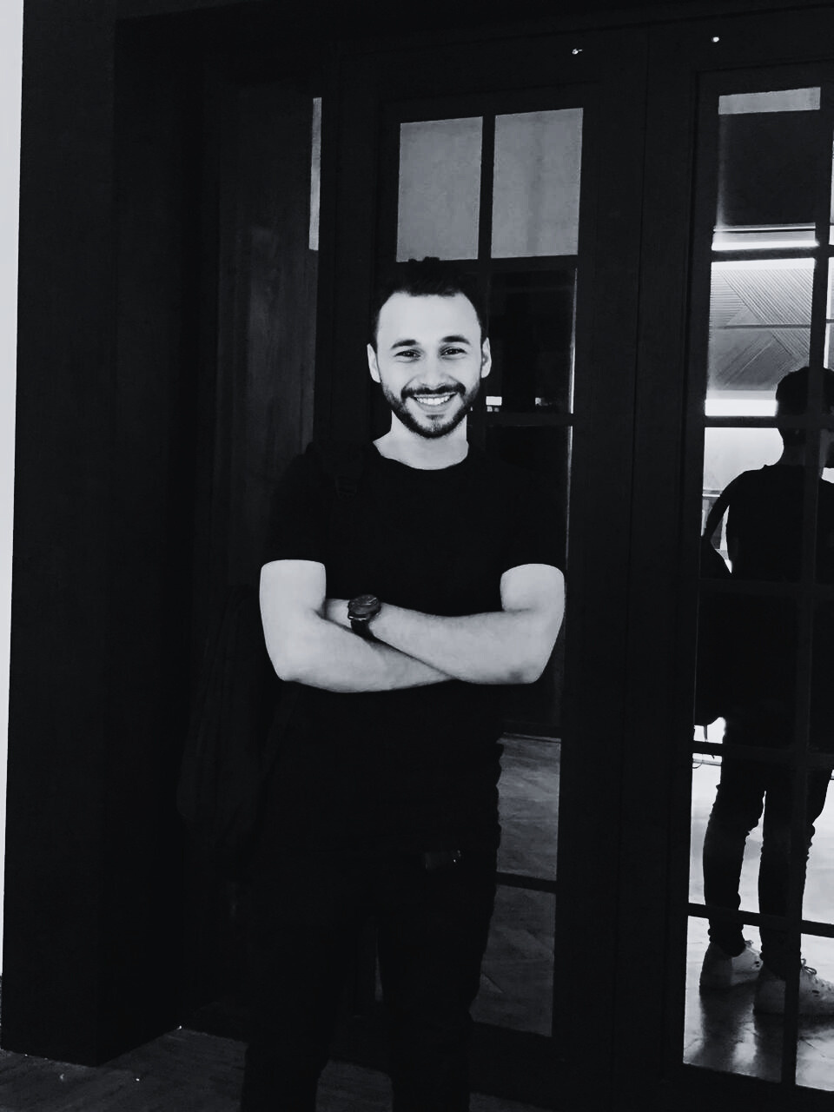
Home
About
Work
Skills
Projects
About Me
I’m a Front-End Developer with over 2 years of hands-on experience building modern, responsive web applications using technologies like React.js, JavaScript (ES6+), Tailwind CSS, and more.
Alongside my development experience, I also have a solid background in customer service and communication, having worked with international brands like Vodafone UK, Canon, and Radisson Hotels.
I’m the co-founder of Graphxify, a digital solutions company serving clients in Canada and internationally. My work focuses on UI/UX design, API integration, and creating high-performance web interfaces.

Slide 3



Home
About
Work
Skills
Projects
1
Front-End Web Developer (Freelancer) - 2023 | Present
Co-founder of Graphxify, a digital solutions company delivering websites, UI/UX design, and branding for international clients (mainly in Canada).
Developed responsive websites using HTML5, CSS3, JavaScript (ES6+), React.js, Tailwind CSS, Bootstrap and more.
Designed intuitive UI/UX interfaces, implemented animations and integrated APIs.
Led full project cycles—from planning to deployment—with a focus on performance and client satisfaction.

Slide 4

Home
About
Work
Skills
Projects
2
International Sales Coordinator – Radisson Hotels Group – Jun 2024 – Apr 2025
Handled inbound calls/emails from international guests, provided service and issue resolution.
Supported sales strategies and developed customer relationships.
Maintained professionalism in guest communication and reporting.

Slide 5
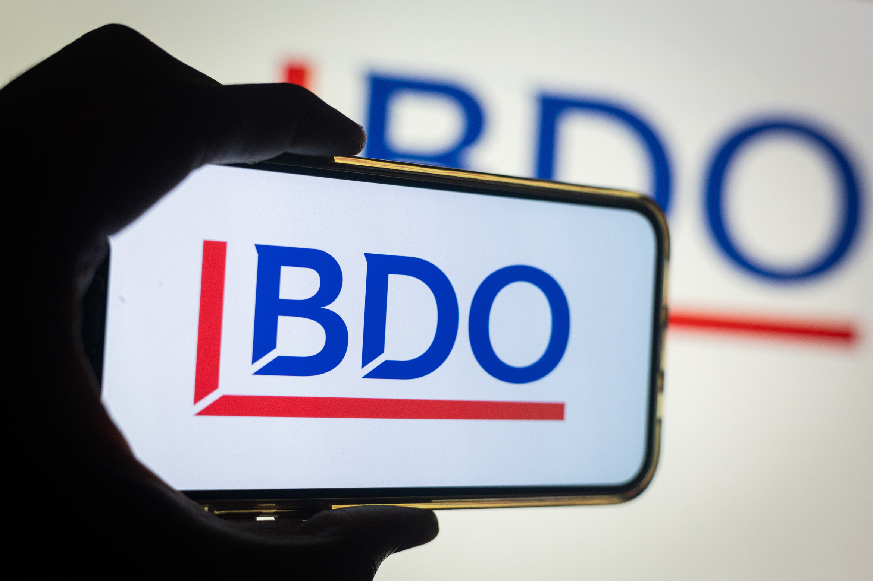



Home
About
Work
Skills
Projects
3
Customer Service Representative – At BDO - Canon Account – Jul 2023 – May 2024
Led and managed a cross-cultural customer service project across Africa and the Middle East.
Created smart tools using excel to identify a lot of things that Reduces the effort and time spent for the team Making the workflow smoother and more seamless than ever before
Created a website regarding the knowledge base using HTML and CSS programming languages
Coordinated effectively with internal teams to meet project goals.

Slide 6
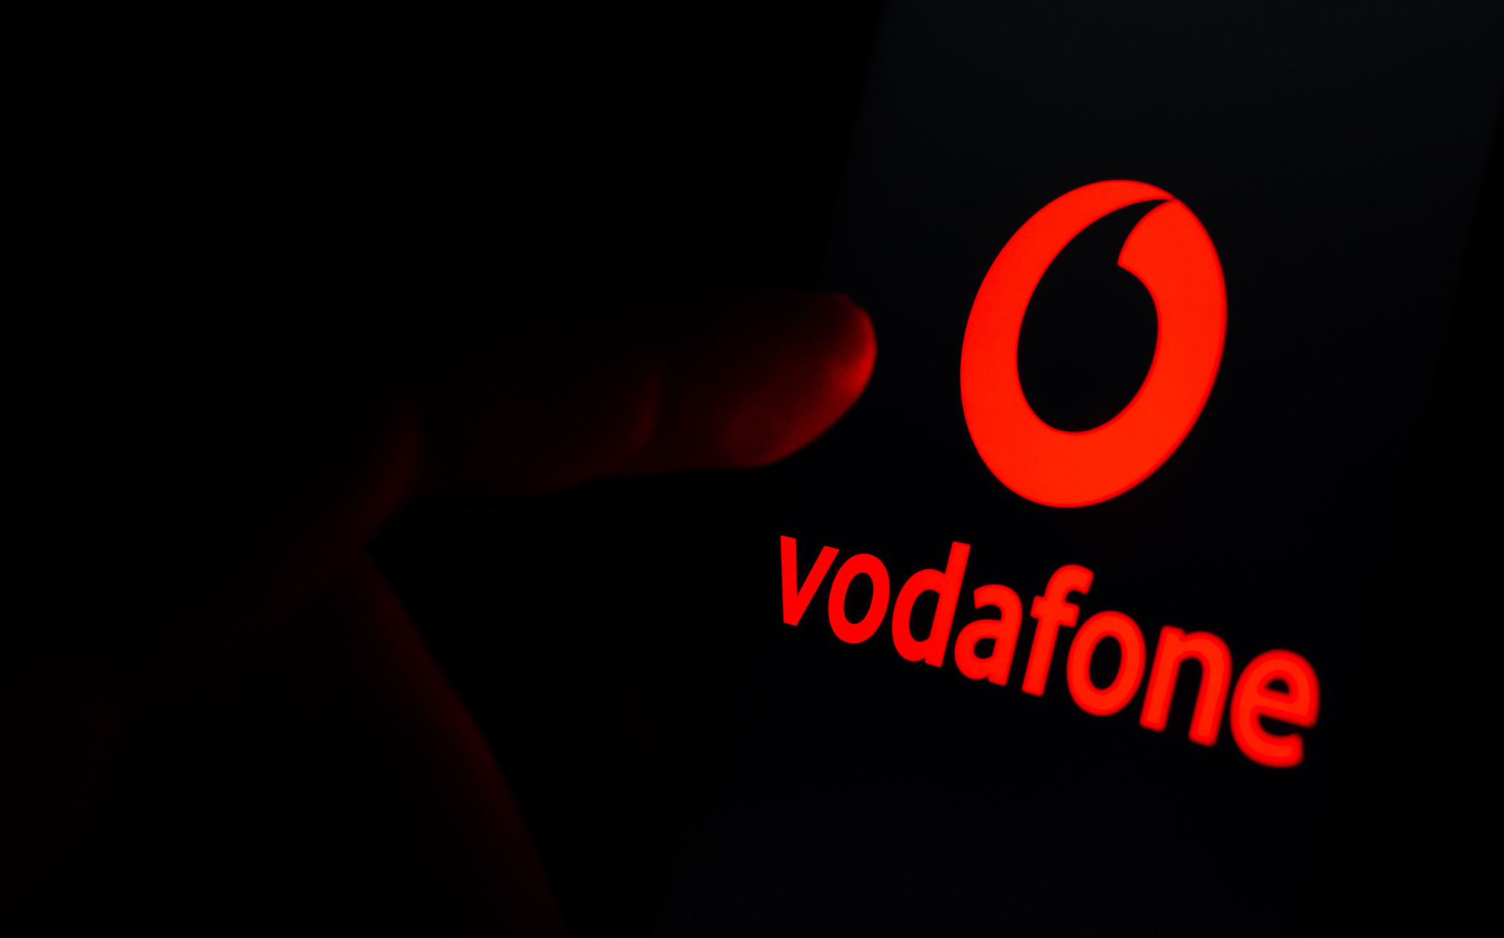
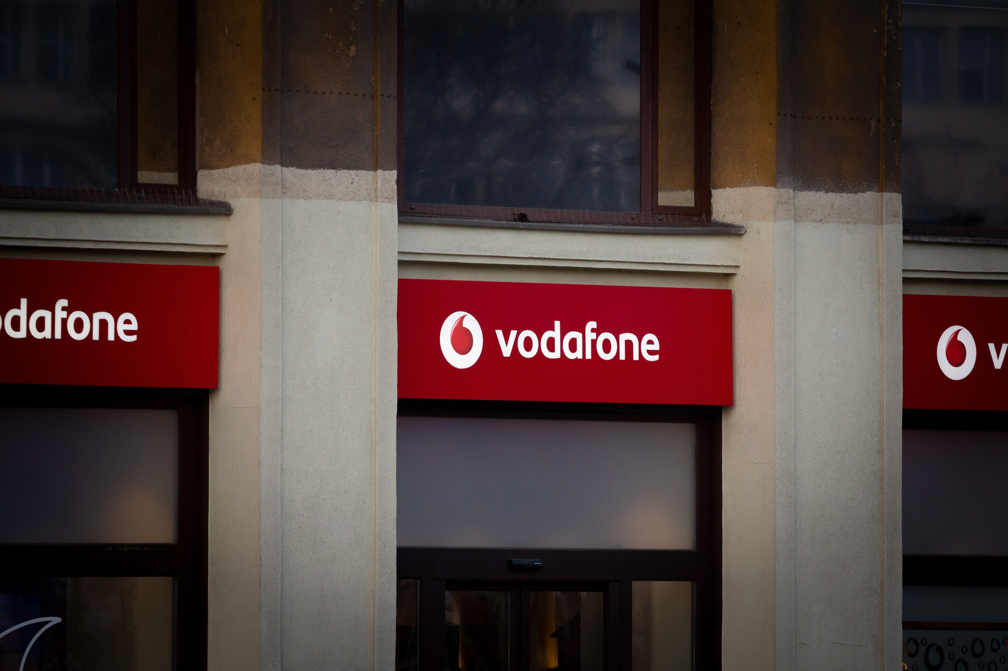
Home
About
Work
Skills
Projects
4
Customer Service Representative – Vodafone UK – 2018 – 2020
Worked with on-site teams to deliver creative ideas to the Vodafone client.
Acted as team leader and delegate manager.
Collaborated with operations, quality, and sales teams to enhance customer experience.

Slide 7



Home
About
Work
Skills
Projects
5
Customer Service Representative – Vodafone Egypt – Insource – 2018
Delivered high-quality service as a Premium and High-Value Representative.
Managed customer interactions efficiently during an 8-month tenure.

Slide 8
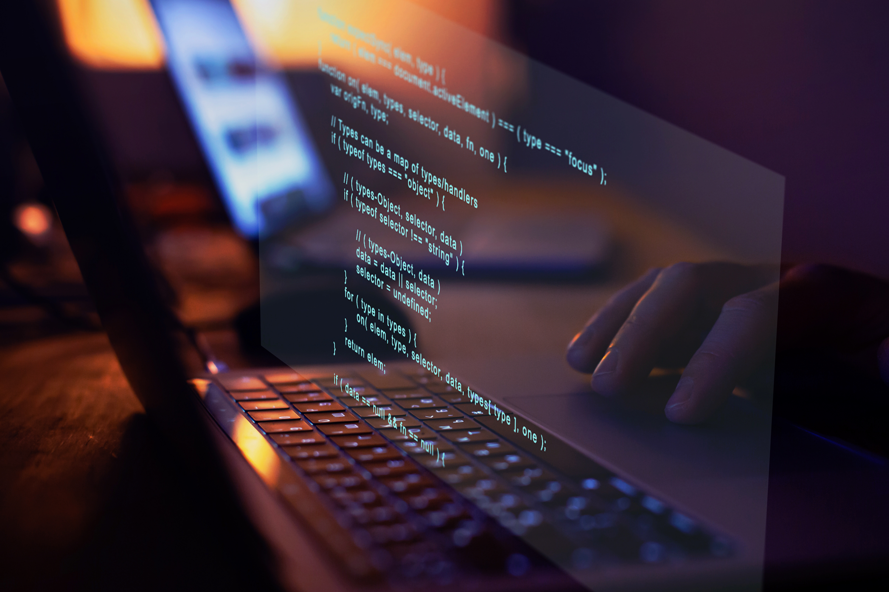
















Home
About
Work
Skills
Projects
Programming
Skills
HTML 5
CSS 3
BOOTSTRAP
SASS
TAILWINDCSS 4
MATERIAL UI
JAVASCRIPT (ES6+)
TYPESCRIPT
REACT.JS
NEXT.JS
REDUX.JS
JQUERY
FIGMA
NPM
GIT & GITHUB
RESPONSIVE DESIGN
API INTEGRATION

Slide 9
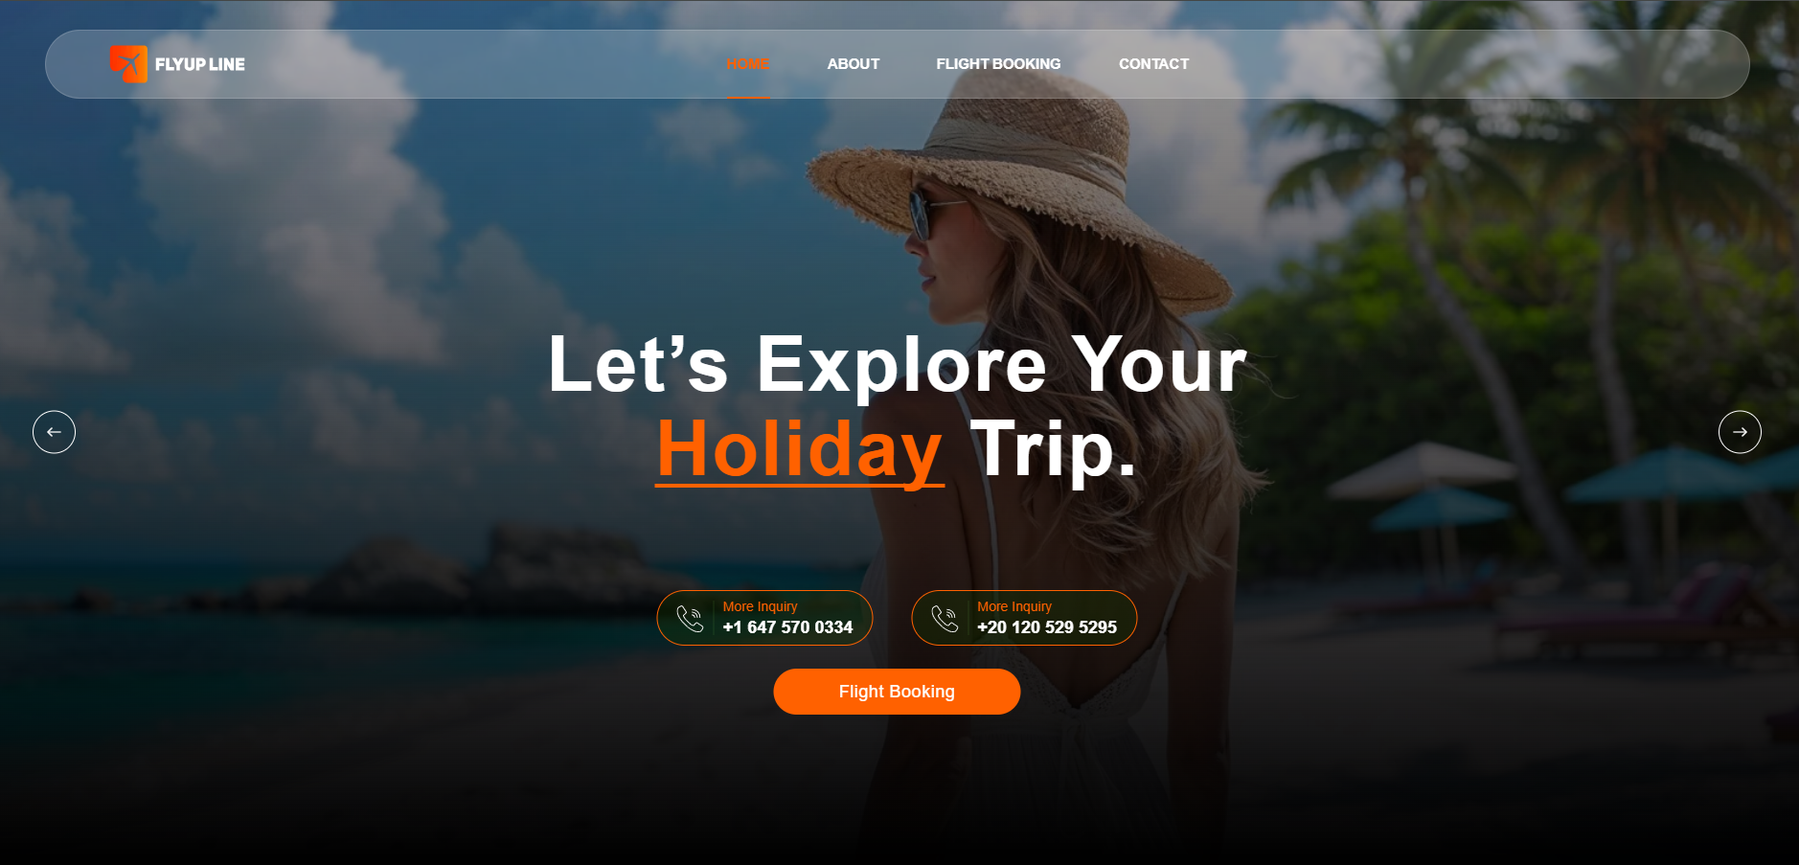

Home
About
Work
Skills
Projects
1
Flyupline
FlyUp Line is a travel agency website I developed, designed to reflect the brand’s commitment to affordability, convenience, and exceptional customer service. The platform showcases their trusted reputation in the travel industry, offering users a smooth and reliable way to access cost-effective travel solutions worldwide.

Slide 10
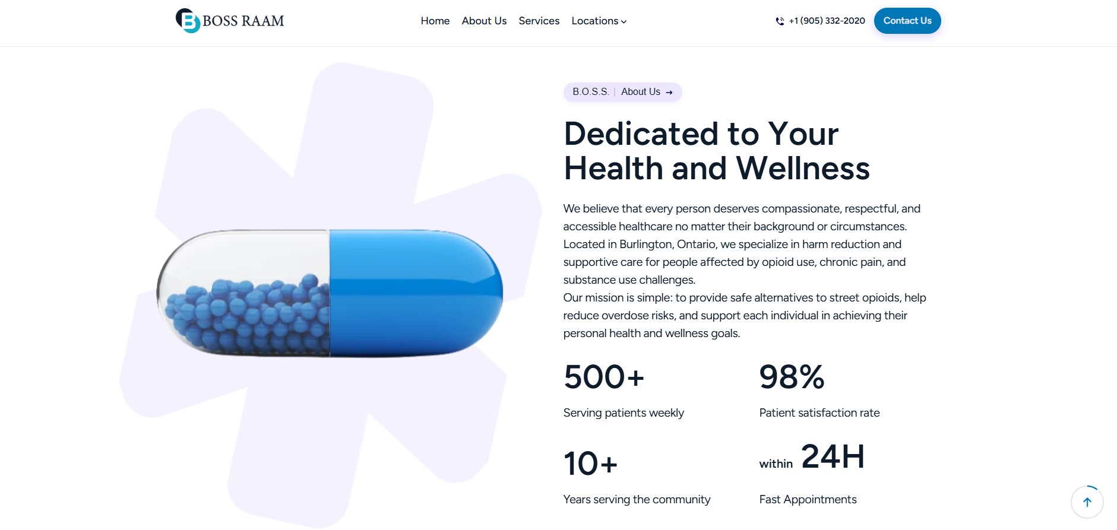
Home
About
Work
Skills
Projects
2
Bossmedclinic
I developed a website for a Burlington, Ontario healthcare organization specializing in harm reduction and supportive care for individuals facing opioid use, chronic pain, and substance use challenges. The site conveys their mission to provide safe alternatives, reduce overdose risks, and support personal health and wellness goals.

Slide 11
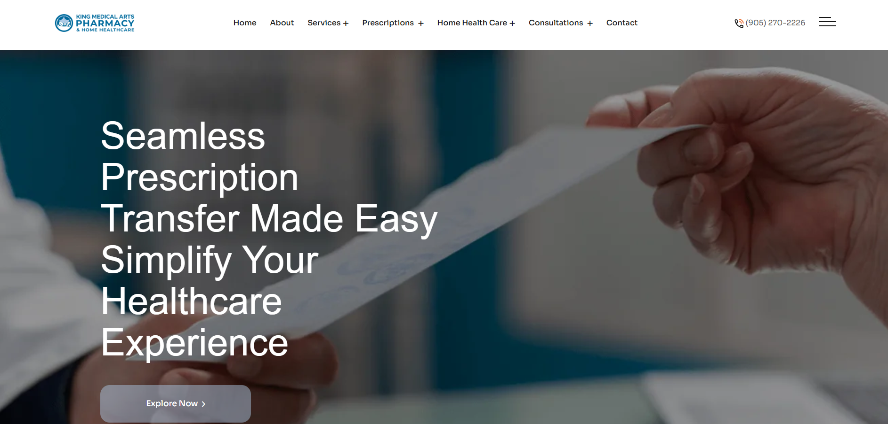
Home
About
Work
Skills
Projects
3
Kingmedicalartspharmacy
I created a website for King Medical Arts Pharmacy and Home Healthcare, a family-run Mississauga pharmacy with over 25 years of service. The site showcases their wide range of offerings — from free delivery and blister packs to mobility aids and online prescription refills — while highlighting their commitment to professional, personalized healthcare.

Slide 12
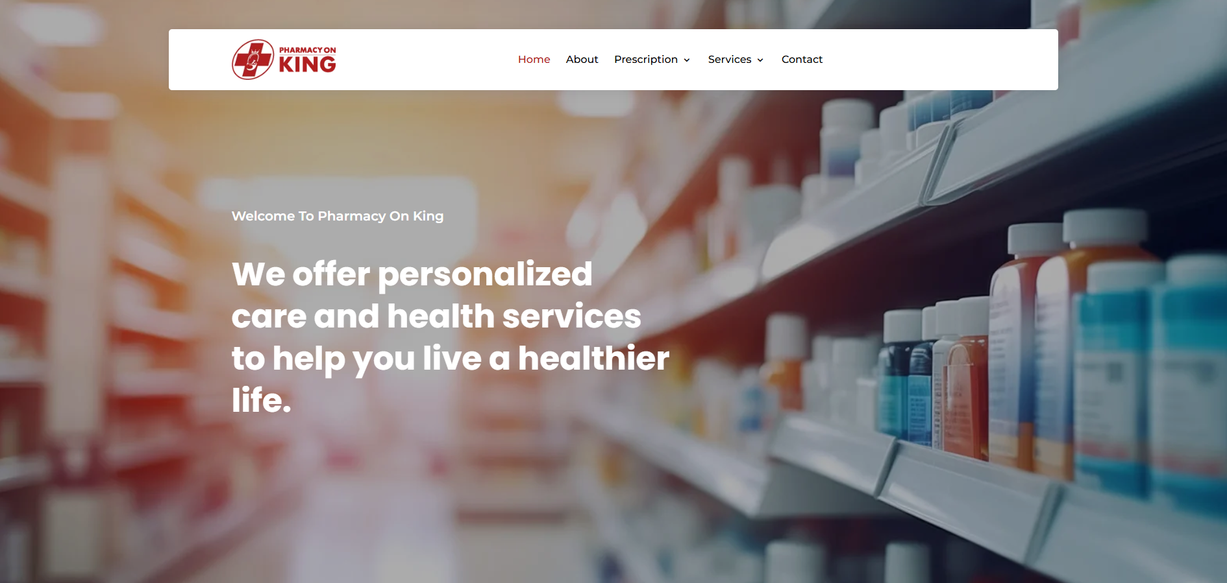
Home
About
Work
Skills
Projects
4
Pharmacyonking
I developed a website for a community-centered pharmacy dedicated to providing personalized healthcare services. The site reflects their mission to go beyond prescriptions, positioning the pharmacy as a cornerstone of health and wellness in the community.

Slide 13

https://www.bdo.com.eg

Slide 14


WHY ARE WE HERE ?
6
5
4
3
The company is currently considering a small update to the Egypt branch’s website – such as adding a page or two. But the real question is:
INTRODUCTION
2
Is that enough to fulfill the purpose of updating the website in the first place?
1
Will this update alone make the user experience as effective as other branches of the company?

Slide 15
WHAT IS THE PURPOSE OF A COMPANY WEBSITE?
6
5
Showcasing products or services.
4
Enhancing customer experience and building trust.
3
A key communication tool with the audience
A direct reflection of the company’s professionalism
2
1
Does the current website truly represent the Egypt branch the same way other branches represent themselves online?

Slide 16

IS A SIMPLE UPDATE THE SOLUTION?
6
5
The Temporary Fix (Current Plan)
4
May add a page.
3
May solve a specific issue.
But it doesn't…
2
Address outdated design.
1
Keep up with regular UI/UX standards and trends.
Allow for maintainability or ongoing development.
Prevent the need for further fixes every time content changes.

Slide 17

A REALISTIC COMPARISON WITH OTHER BRANCHES
6
5
For example: Canada or U.K. branch has an in-house technical team that regularly monitors and updates the website.
4
3
They constantly improve:
And this clearly reflects on:
2
Content
Higher search rankings
Design
Greater customer trust
1
SEO
These teams aren’t just updating a website — they’re building a long-term connection between users and the brand, leading to trust and continuity.

Slide 18

WHY LONG-TERM VALUE IS BETTER
6
5
Saves time and effort in the long term.
4
Reduces cost compared to hiring a freelancer each time.
Enables quick responses to sudden issues or urgent changes.
3
Continuously improves the user experience.
Keeps up with browser and tech updates.
2
And The Keypoint here:
1
To monitor and enhance performance constantly, just like other branches already do.

Slide 19

CONCLUSION
6
A website is not just a few pages — it's the company's digital front.
5
And just like other branches invest in theirs, this one deserves the same level of care.
4
Current Website Issues:
3
1 - Favicon is bugged in Google search.
11 - Industry pages and others lack images.
2 - 'Our People' page filter section is broken.
12 - Most pages lack banner images
3 - No social media buttons (unlike other regions).
13 - 'Home' page has a broken 'Sign up' button.
2
4 - Website description is bugged in Google search.
5 - 'About > Global Network' page has spacing issues
1
6 - 'The BDO Esnad - Story' page has design issues (spacing after title).
7 - Footer section has minimal content compared to other regional sites.
8 - Navbar shows pointer cursor on non-clickable items should be default
9 - 'Contact Center Outsourcing' page has poorly designed image section.
10 -'Locations - Giza' lacks a banner image and has a very low-quality building photo.

Slide 20
THANK
YOU
01272249564
shadymedhat98@gmail.com

